Slide 1
Welcome To The KIDS ZONE!

Slide 2
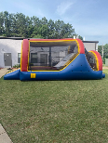
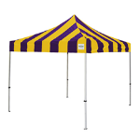
Kids zone overview
Play
-N-
Prize
Make -N- Take
5 & under

Slide 3
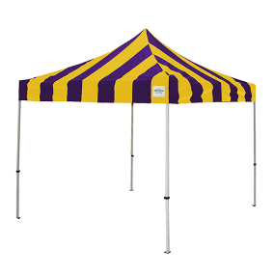
The front of the Kids Zone

Slide 4
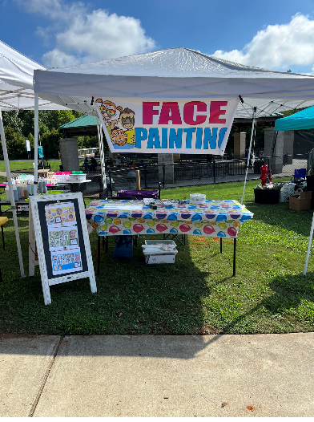
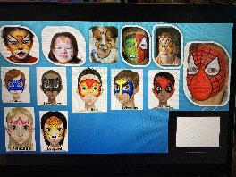
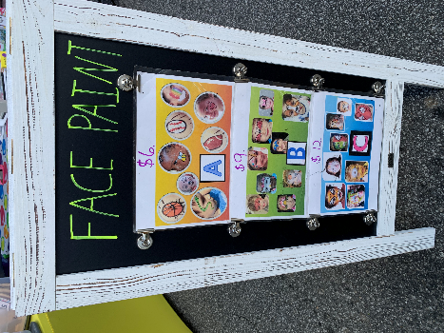
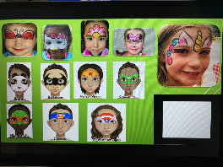
Face paint

Slide 5
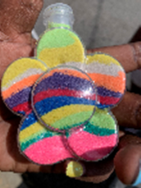
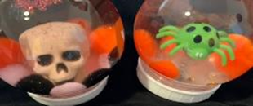
Make -n- Takes

Slide 6
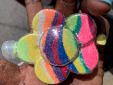
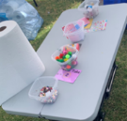
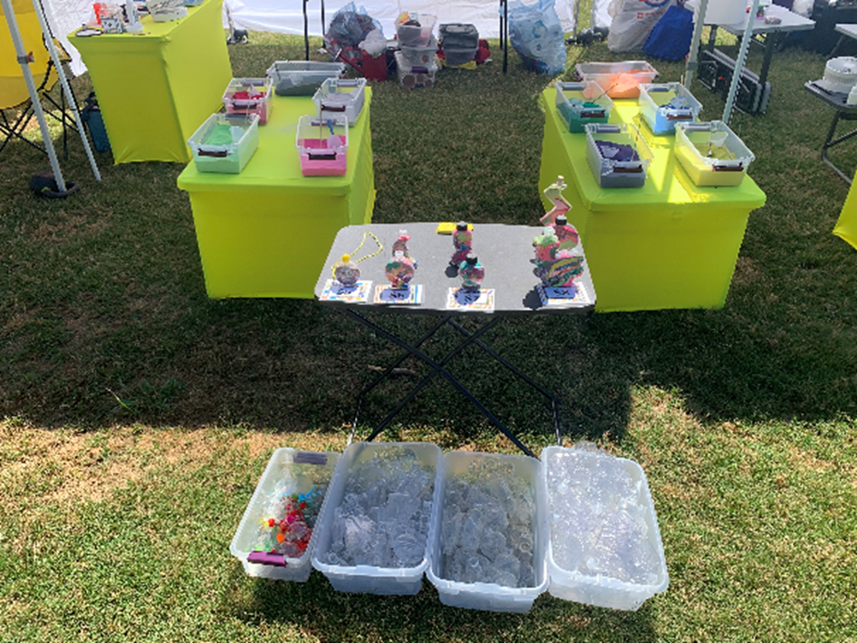
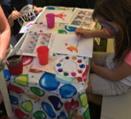
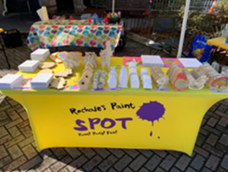
Paint & Sand Art
Decoration Table
Items to
Paint & Decorate:
Canvases
2D & 3D wood
Ceramics
Styrofoam
Table where Kiddos paint
Sand Art

Slide 7
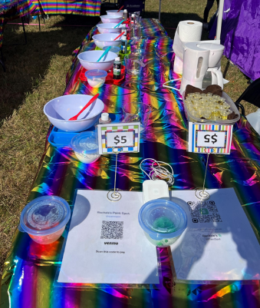
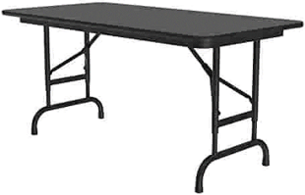
Make Play-doh & make fun Cakes
Table where Kiddos Make their own Play-Doh! (premeasured ALL NATURAL ingredients)
Table where Kiddos Make their own
“FUN Cakes”! ☺
Kiddos will, mix ingredients, cook, and add toppings!

Slide 8
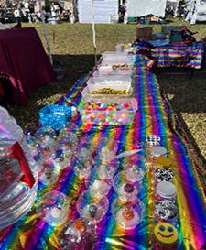
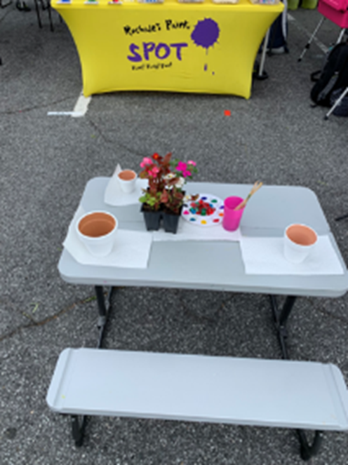
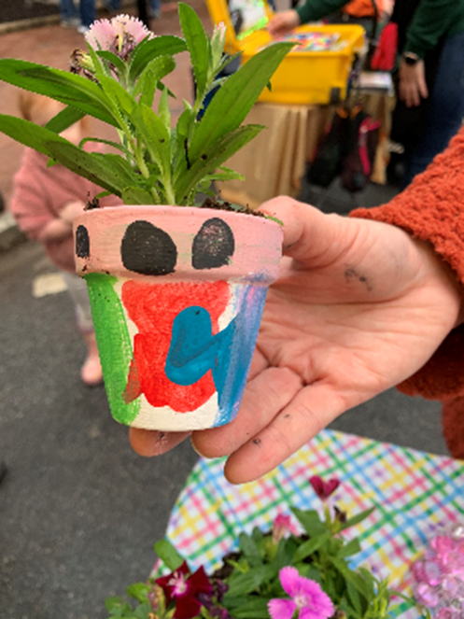
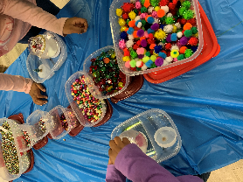
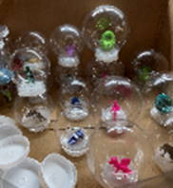
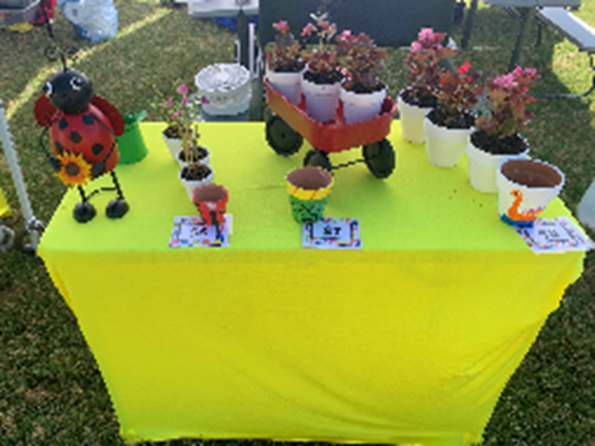
Make snow globes (Yearly) & Flowerpots (Paint, decorate & Plant flowers)
Display Table
Table where Kiddos Make their own Snow Globe
Table where Kiddos
Paint their pots and
Plant flowers

Slide 9
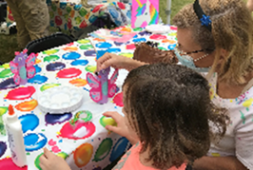
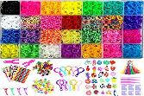
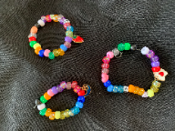
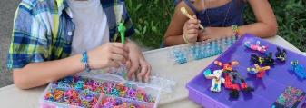
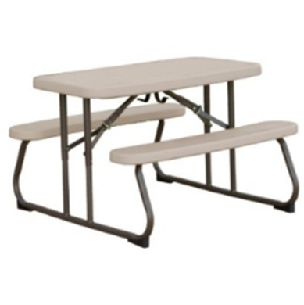
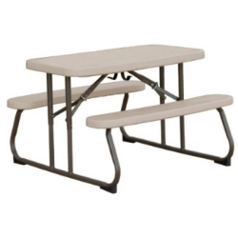
Make Jewelry & Make Crafts
Display Table
Bench Table where kiddos Create their own jewelry
Table where Kiddos Create their own crafts

Slide 10
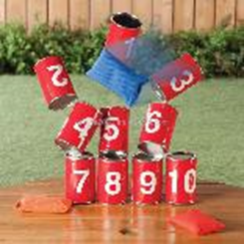
play for a prize!

Slide 11
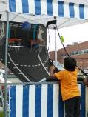
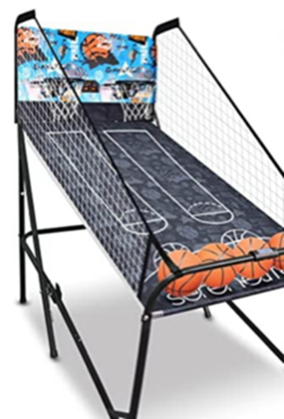
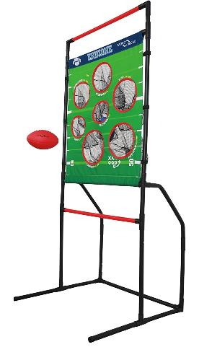
Let’s play ball!
Prize Table

Slide 12
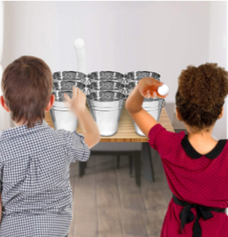
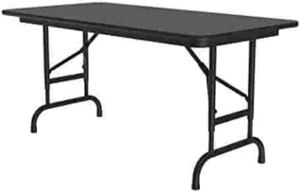
Cans Down! & Ping pong toss
Prize Table

Slide 13
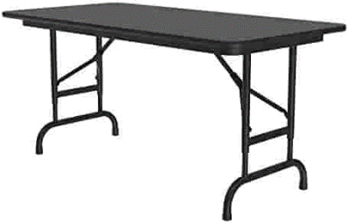
Hit the moving target! & dinosaur roar to score
Prize Table

Slide 14
Stay & play ages 2 and younger

Slide 15
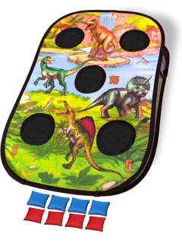
Stay & play (bowling bean bag toss bubbles sand table tent)

Slide 16
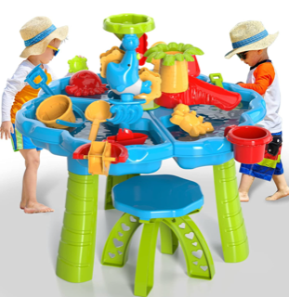
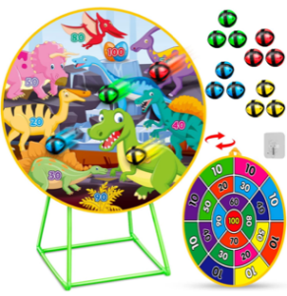
Stay & play (water table darts bubbles & hoops)

Slide 17
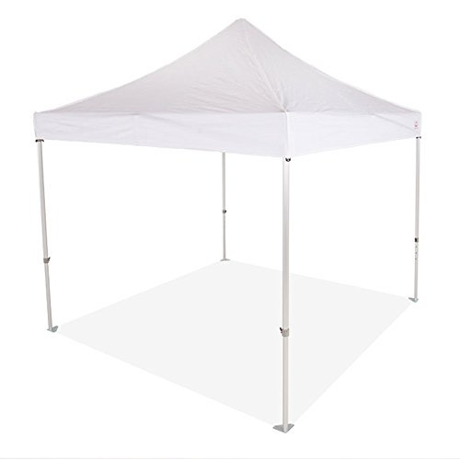
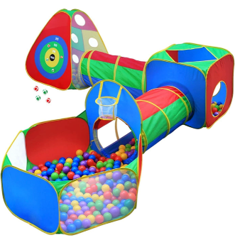
Hide n slide

Slide 18
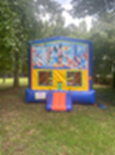
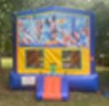
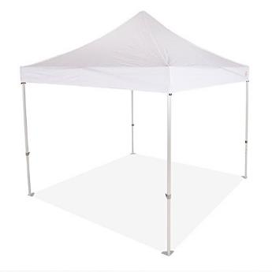
Bouncy houses
Wrist Band Unlimited Play

Slide 19
Hot dogs & SWEET TREATS

Slide 20
tickets

Slide 21
Enjoy the zone (free football Challenge connect 4 balloons & coney island toss)

Slide 22
win! Win! Win (egg in spoon race three-legged race potato sack race)

Slide 23
Vision and Mission Statement
The Vision of Rochale’s Paint Spot is to instill in our artist and community a life-long passion for the arts particularly the visual arts that results in personal and professional artistic pursuits beyond their wildest imaginations.
The Mission of Rochale’s Paint Spot is to provide creative challenges, development, fun and engaging opportunities that will ignite a personal passion for art.

Slide 24
how exciting!
THANK YOU
If you have any questions, please contact Rochale’s Paint Spot at:
rochalespaintspot@gmail.com
(470)720-0022
(770)845-6361

