Slide 1
Welcome To The KIDS ZONE!

Slide 2
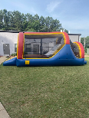
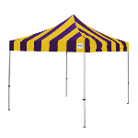
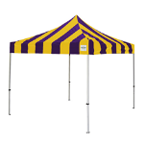
Kids zone overview
Play
-N-
Prize
Make -N- Take
5 & under

Slide 3
The front of the Kids Zone

Slide 4
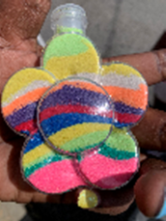
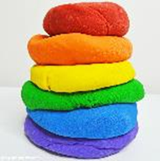
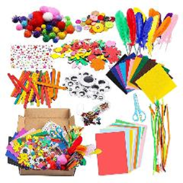
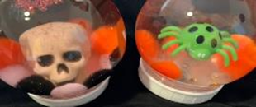
Make -n- Takes

Slide 5
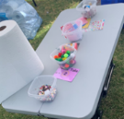
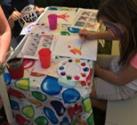
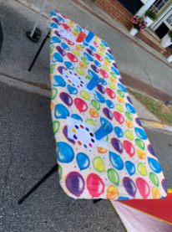
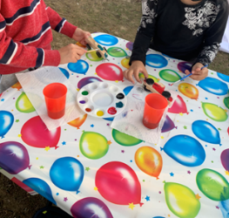
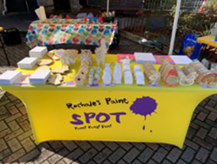
Come Paint with us!
Decoration Table
Bench Table where Kiddos paint
Display Table
Items to Paint & Decorate:
Canvases
2D & 3D wood
Ceramics
Styrofoam
Table where Kiddos paint
Table where Kiddos paint

Slide 6
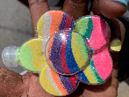
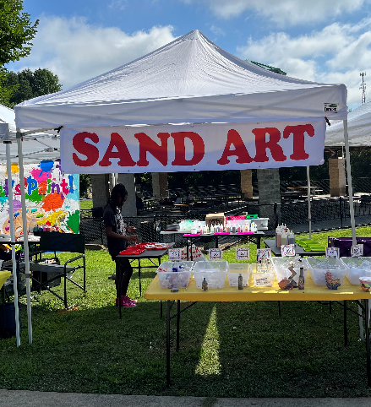
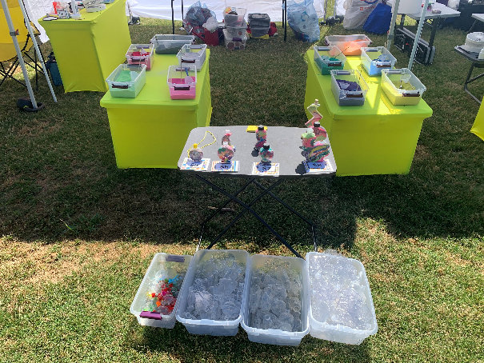
Sand Art

Slide 7
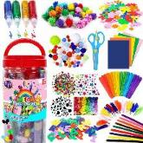
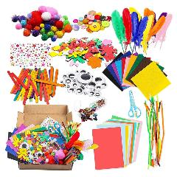
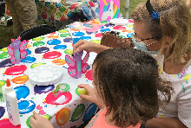
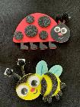
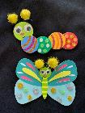
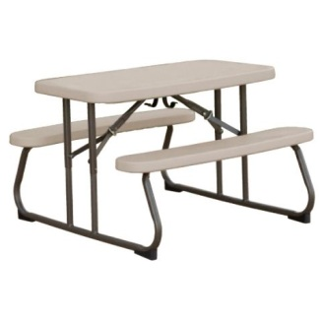
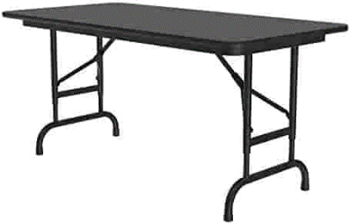
Make Crafts
“Foam, Peel & stick”
Display Table
Table where Kiddos Create
Table where Kiddos Create

Slide 8
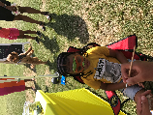
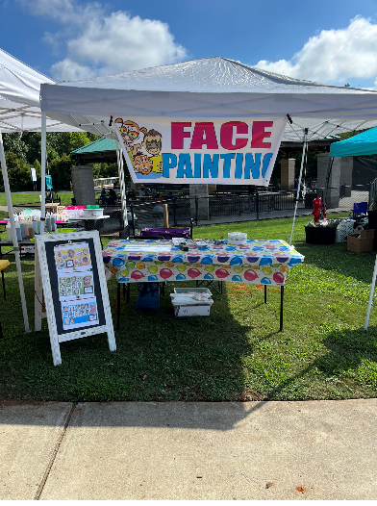
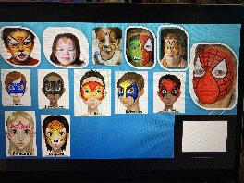
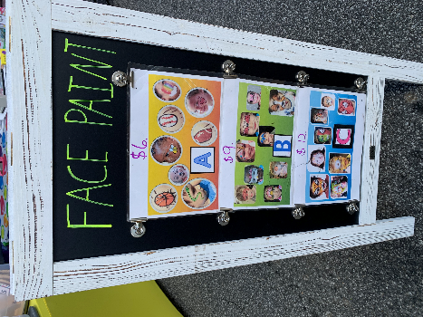
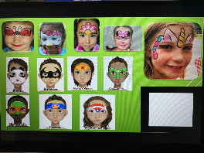
Face paint

Slide 9
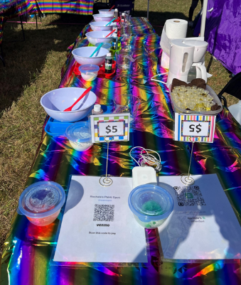
Make Play-doh
Table for kiddos to play with their own Play-Doh
Table where Kiddos Make their own Play-Doh! (premeasured ALL NATURAL ingredients)
Display Table
Table where Kiddos Make their own Play-Doh! (premeasured ALL NATURAL ingredients)

Slide 10
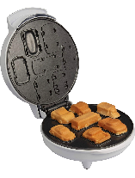
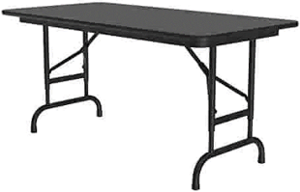
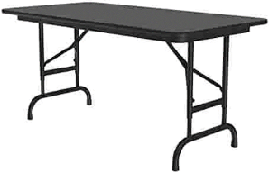
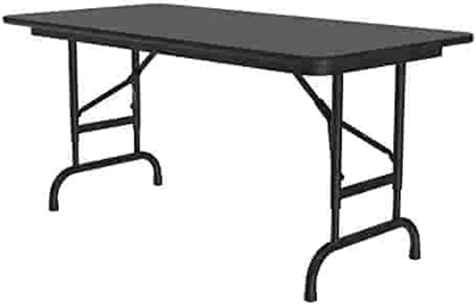
make fun Cakes
Cooking Table 6-12 stations:
Cars
Unicorns
Dinos
Animals
Ocean Life
Mermaid
Galaxy
Emojis
Mix Ingredients Table
Choose a color:
Red
Blue
Green
Toppings Table
Powder Sugar
Sprinkles
Fruit
Display Table
Display Table

Slide 11
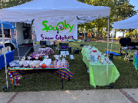
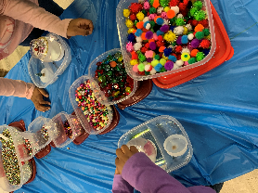
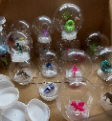
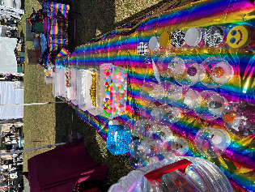
Make snow globes (Yearly)
Table where Kiddos Make their own Snow Globe
Display Table
Table where Kiddos Make their own Snow Globe

Slide 12
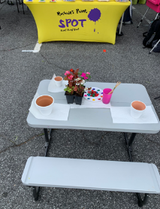
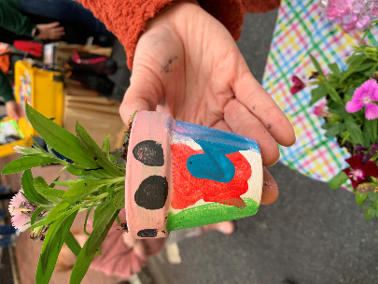
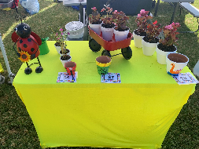
Flowerpots (Paint, decorate & Plant flowers)
Bench Table where Kiddos Paint their pots and Plant flowers
Display Table
Table where Kiddos Paint their pots and Plant flowers

Slide 13
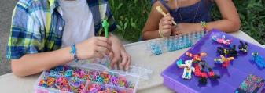
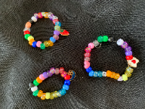
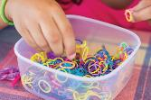
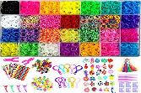
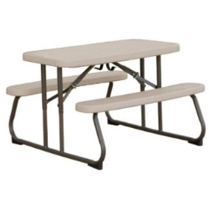
Make Jewelry
Bench Table where kiddos Create their own jewelry
Display Table
Table where Kiddos Create their own jewelry

Slide 14
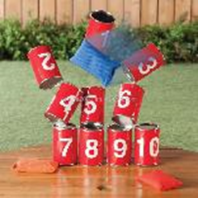
play for a prize!

Slide 15
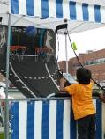
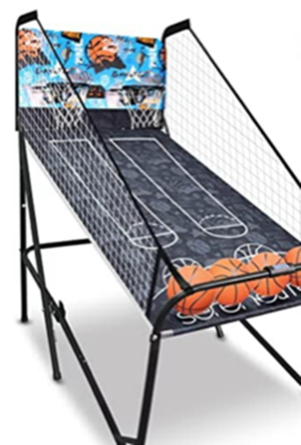
HOOP it up
Prize Table

Slide 16
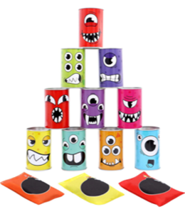
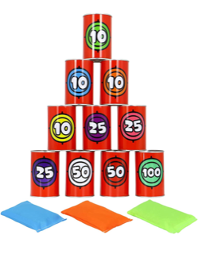
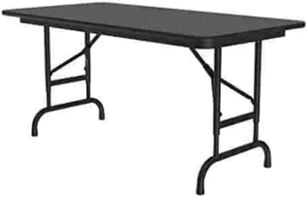
Cans Down!
Prize Table

Slide 17
Hit the moving target!
Prize Table

Slide 18
Throw the pass
Prize Table

Slide 19
dinosaur roar to score
Prize Table

Slide 20
Ping pong toss
Prize Table

Slide 21
Darts
Prize Table

Slide 22
Stay & play ages 2 and younger

Slide 23
Stay & play (bowling bean bag toss bubbles sand table tent)

Slide 24
Stay & play (water table darts bubbles & hoops)

Slide 25
Hide n slide

Slide 26
Bouncy houses
Wrist Band Unlimited Play

Slide 27
tickets

Slide 28
Hot dog stand (hot dogs popcorn & drinks)

Slide 29
SWEET TREATS

Slide 30
tickets

Slide 31
tickets

Slide 32
Enjoy the zone (free football Challenge connect 4 balloons & coney island toss)

Slide 33
win! Win! Win (egg in spoon race three-legged race potato sack race)

Slide 34
Vision and Mission Statement
The Vision of Rochale’s Paint Spot is to instill in our artist and community a life-long passion for the arts particularly the visual arts that results in personal and professional artistic pursuits beyond their wildest imaginations.
The Mission of Rochale’s Paint Spot is to provide creative challenges, development, fun and engaging opportunities that will ignite a personal passion for art.

Slide 35
how exciting!
THANK YOU
If you have any questions, please contact Rochale’s Paint Spot at:
rochalespaintspot@gmail.com
(470)720-0022
(770)845-6361

